Slide 1
Basic elements of organizing
Chapter 8
Miami Dade College
Sep 28th, 2019

Slide 2
Organizing
Organizing: how best to group organizational elements
OR
How to configure the building blocks to gain a CA
Two parts:
Focusing on the building blocks: Organization Structure
Focusing on how to put the blocks together: Organization design

Slide 3
Building blocks
6 building blocks to construct an organization:
Designing jobs,
Grouping jobs,
Establishing reporting relationships between jobs,
Distributing authority among jobs,
Coordinating activities among jobs,
Differentiating among positions

Slide 4
Designing jobs
Determination of an individual’s work-related responsibilities
- Defining areas of decision making responsibilities
- Identifying goals and expectations
Establishing appropriate indicators of success
Job specialization: the overall task of the organization is broken down and divided into smaller parts
Job description:
A list of the tasks, duties and responsibilities that a job entails
Job specification:
A list of the knowledge, skills, abilities and other characteristics that an individual must have to perform a job

Slide 5
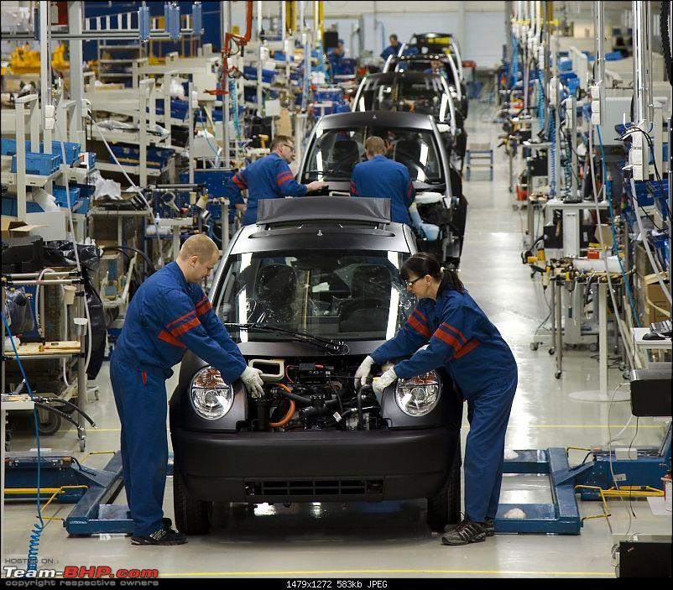

Slide 6
Limitations of specialization
Workers who perform highly specialized jobs may become bored and dissatisfied (doing the same task over and over…)
Specialized job might offer no challenge
Boredom and monotony Absenteeism
Quality of job
Managers should avoid extreme specialization
Conclusion:
Some degree of specialization is necessary
High level of specialization has possible negative consequences
So, What are the alternatives???

Slide 7
Alternatives to specialization
Balancing demands for productivity and creativity and autonomy
Five approaches:
Job rotation: Moving employees from one job to another
Training device to improve skills and flexibility
2. Job enlargement: increasing the total number of tasks workers perform
Performing wide variety of tasks which reduces the level of job dissatisfaction
Training costs increase

Slide 8
Continued…
3. Job enrichment:
Increasing the range and variety of tasks is sufficient???
Both the number of tasks and the control the worker has over the job
Removing some controls from the job
Delegating more authority to employees
Assigning new and challenging tasks
Increasing employees’ opportunity for growth
4. Job characteristics approach:
- Jobs should be improved along five core dimensions

Slide 9
Continued…
1. Skill variety: the number of tasks
2. Task identity: completing a portion of the total job
3. Task significance: the perceived importance of the task
4. Autonomy: the degree of control
5. Feedback: how well the jobs is being performed
Workers experience meaningfulness and responsibility and become motivated
5. Work teams: assigning specific tasks to members and monitoring their performance

Slide 10
Grouping jobs: departmentalization
Dividing organizations into separate units
It can save costs and improve efficiency
1.Functional departmentalization:
Especially among smaller organizations
Grouping those jobs involving the same activities
Organizational functions: Marketing, finance, HR, accounting, production…
Coordinating activities inside each department is easier
Employees may follow their department’s goals rather than organization’s goals

Slide 11
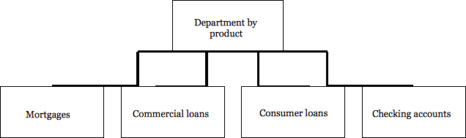
Continued…
2. Product departmentalization:
Grouping activities around products
All activities associated with a product can be easily integrated
Speed of decision making is enhanced

Slide 12
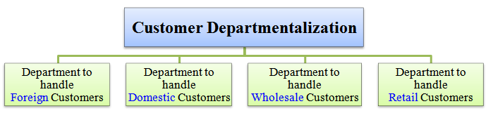
Continued…
3. Customer departmentalization:
Structuring activities which interact with specific customers
Using skilled specialists to deal with unique customers

Slide 13
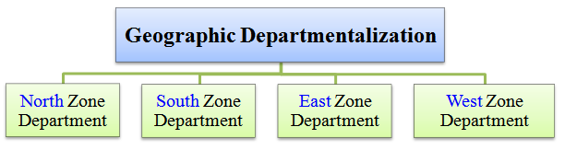
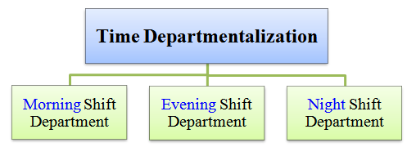
Continued…
4. Location departmentalization:
Grouping jobs based on geographic areas
Other forms:
Each shift has its own functional
departments
- Hospitals,…

Slide 14
Establishing reporting relationships
Clarifying the chain of command:
Clear lines of authority among all positions
From the lowest to highest position in the organization
Span of control:
How many people will report to each manager
Narrow: few subordinates per manager
Wide: many subordinates
Tall vs flat organizations:
- Tall: many layers of management involved
- Narrow span of control
- More expensive

Slide 15
Continued…
Flat: fewer managers and more responsibility
Wide span of control (more subordinates reporting to each manager)
Speeding up decision making
Appropriate span?
Both managers and subordinate are well trained, a wide span is effective
More widely subordinates are scattered, the narrower span is effective
More interaction is required, the narrower span is effective

Slide 16
Distributing authority
Power that has been legitimized by the organization
1. Delegation: managers assign a portion of their total workload to others
In some cases, subordinates may have more expertise in addressing a particular problem
Some managers worry that subordinates will be a threat to their own advancement
2. Decentralization: delegating power and authority throughout the organization to middle and lower-level managers
3. Centralization: retaining power and authority in the hands of higher-level managers
The greater the complexity of the environment decentralization
The riskier the decisions centralization
Ability of lower-level managers decentralization

Slide 17
Coordinating activities
The process of linking the activities of the various departments of the organization
The departments and work groups are interdependent
Three forms of interdependence:
Pooled interdependence: little interaction between units
The output (profits or losses) of the units is pooled at the organizational level
i.e.: the stores of a company have its own budget, staff,…
2. Sequential interdependence: the output of one unit is the input for another
i.e.: assembly line

Slide 18
Continued…
3. Reciprocal interdependence:
i.e.: the interaction between reservation department and front desk check in
Coordination techniques:
Managerial hierarchy: one manager is in charge of interdependent departments
Rules and procedures: standard procedures to handle routine coordination
Liaison roles: managers in liaison role simply facilitate the flow of information
Task forces: drawing one representative from each group
Integrating departments: the permanent task force

Slide 19
Differentiating between positions
Line personnel: employees who are part of the chain of command that is responsible for achieving organizational goals
They have formal authority to make policy decisions
i.e.: production, sales, marketing
Staff personnel: employees who advise and assist line personnel in meeting their goals
They have authority to advise and support line personnel
i.e.: legal advisor, auditing, recruitment, training, accounting
Administrative intensity: the degree to which managerial positions are concentrated in staff position
High administrative intensity: many staff positions relative to the number of line positions

Slide 20
Organization design
The relationships among the structural elements used to manage the total organization
A means to implement strategies
Two universal perspectives:
1. Bureaucratic model
- Organization design based on a legitimate and formal system of authority
Established hierarchy of positions that creates a chain of command
It improve efficiency but results in inflexibility
i.e.: government agencies and universities
2. Behavioral model:
The emergence of the human relations and interpersonal processes
Concepts such as: leadership, decision making, motivation, communication, interactions,…

Slide 21
Second individual assignment
Select a company (local or international)
Analyze the organization structure based on the 6 core elements as follows:
1. How they have designed jobs?
2. How they have grouped jobs?
3. How they have established reporting relationships between jobs?
4. How they have distributed authority among jobs?
5. How they have coordinated activities among jobs?
6. How they have differentiated among positions (line and staff personnel)?
Min 3 pages
The assignment will be due on Oct 5th at 11:59 pm

